Slide 1

Lecture 7
$z$-Transform

Slide 2
Motivation
Fourier Transform provides a frequency domain representation of discrete-time signal, but it may not exist for some sequences. (Reason?)
Not easy for algebraic manipulations.
z-transform used for:
Analysis of LTI systems
Solving difference equations
Determining system stability
Finding frequency response of stable systems

Slide 3
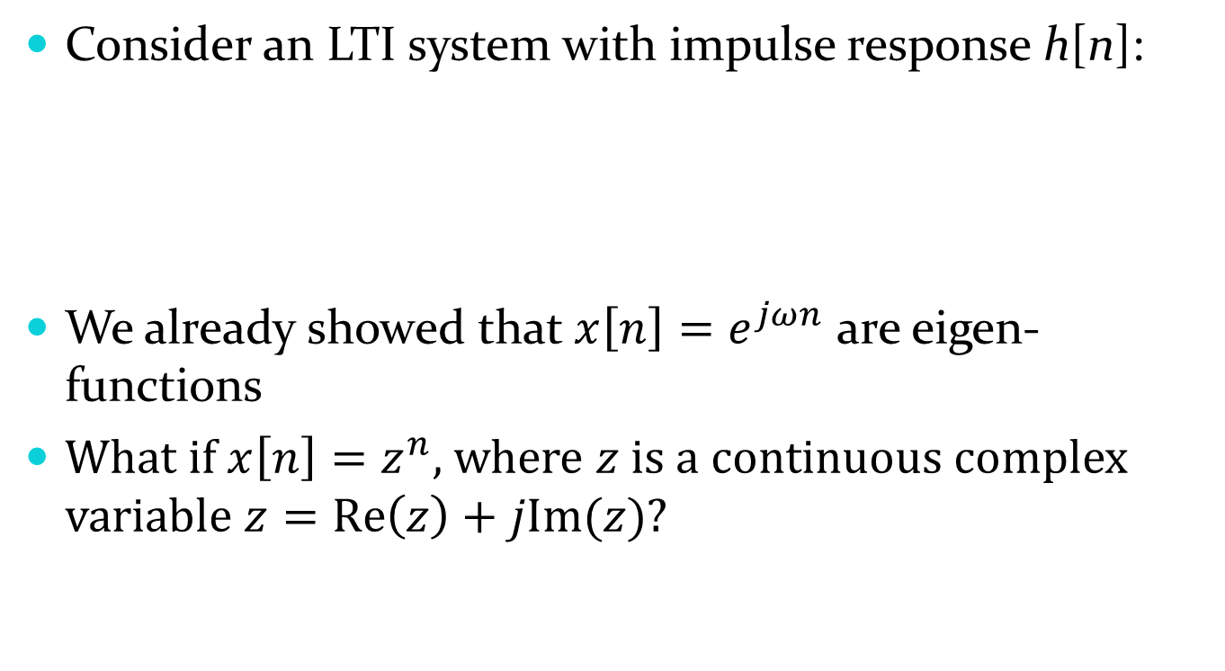
Eigen Functions of LTI Systems
Consider an LTI system with impulse response h[n]:
We already showed that $x\left[n\right]=e^{jωn}$ are eigen-functions
What if $x\left[n\right]=z^{n}$, where $z$ is a continuous complex variable $z=Re\left(z\right)+jIm(z)$?
x[n]
y[n]
h[n]

Slide 4

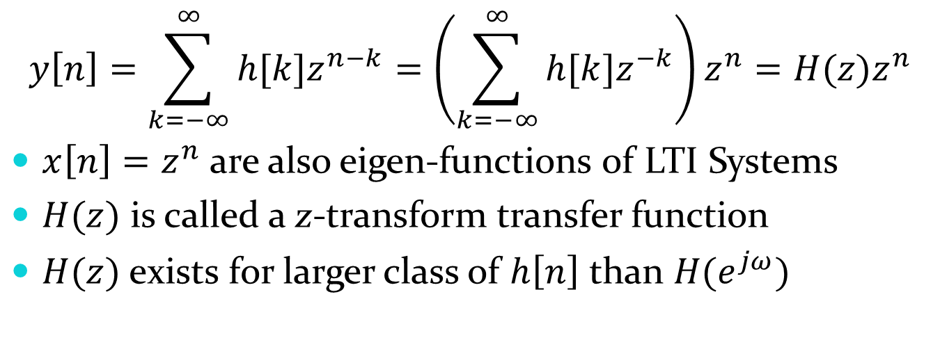
Eigen Functions of LTI Systems
$$z^{n}$$
y[n]
h[n]
$$y\left[n\right]=\sum_{k=−∞}^{∞}{h[k]z^{n−k}}=\left(\sum_{k=−∞}^{∞}{h[k]z^{−k}}\right)z^{n}=H(z)z^{n}$$
$x\left[n\right]=z^{n}$ are also eigen-functions of LTI Systems
$H(z)$ is called a z-transform transfer function
$H(z)$ exists for larger class of $h\left[n\right]$ than $H(e^{jω})$

Slide 5

Definition
z-Transform:
$$X\left(z\right)=Z\left\{x\left[n\right]\right\}=\sum_{n=−∞}^{∞}{x\left[n\right]z^{−n}}$$
where, z is a complex variable.
Example
$$X\left(z\right)=2+4z^{−1}+6z^{−2}+4z^{−3}+2z^{−4}+z^{−5}$$
n | n ≤ −1 | 0 | 1 | 2 | 3 | 4 | 5 | n > 5
x[n] | 0 | 2 | 4 | 6 | 4 | 2 | 1 | 0

Slide 6
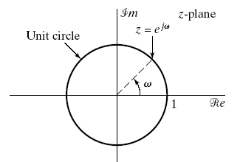
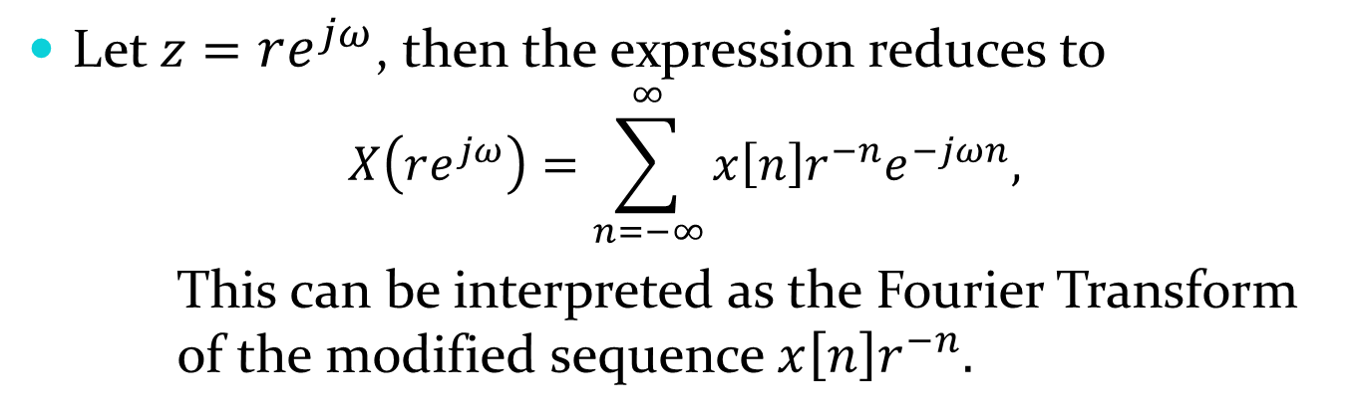


$z$-Transform vs. DTFT
Let $z=re^{jω}$, then the expression reduces to
$$X\left(re^{jω}\right)=\sum_{n=−∞}^{∞}{x\left[n\right]{r^{−n}e}^{−jωn},}$$
This can be interpreted as the Fourier Transform of the modified sequence $x\left[n\right]r^{−n}.$
If $r=1\left(i.e., \left|z\right|=1\right)$, the z-transform reduces to DTFT.
The contour $\left|z\right|=1$ is a circle in the z plan of unity radius, called unit circle.

Slide 7

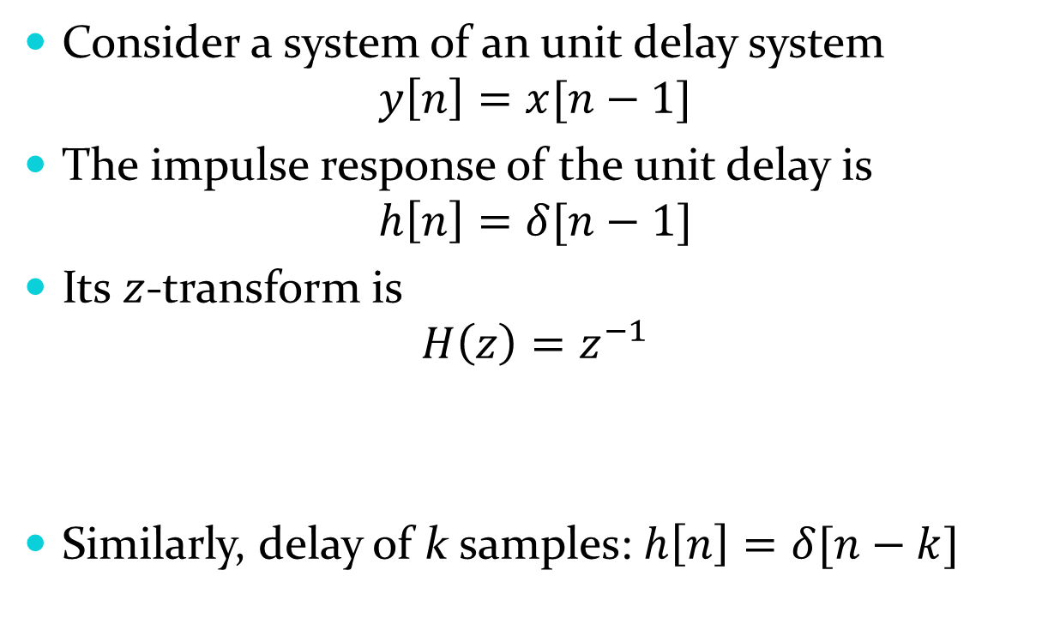


z-Transform and LTI system
Consider a system of an unit delay system
$$y\left[n\right]=x[n−1]$$
The impulse response of the unit delay is
$$h\left[n\right]=δ[n−1]$$
Its $z$-transform is
$$H\left(z\right)=z^{−1}$$
Similarly, delay of k samples: $h\left[n\right]=δ[n−k]$
$$z^{−1}$$
$$z^{−k}$$
$$H\left(z\right)=z^{−k}$$

Slide 8
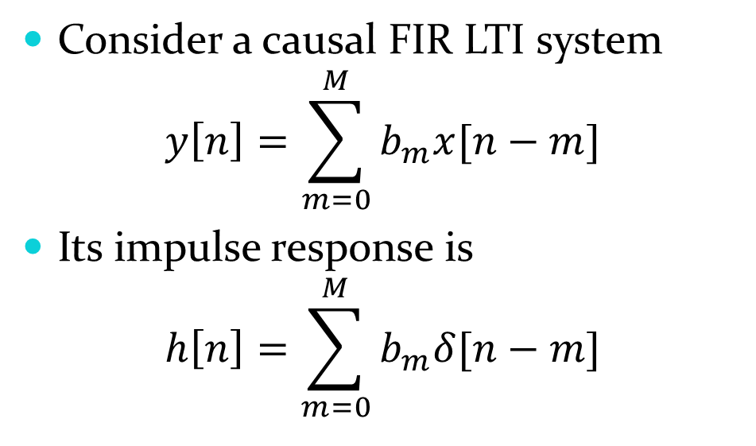





$z$-Transform of FIR System
Consider a causal FIR LTI system
$$y\left[n\right]=\sum_{m=0}^{M}{b_{m}x[n−m]}$$
Its impulse response is
$$h\left[n\right]=\sum_{m=0}^{M}{b_{m}δ[n−m]}$$
$$x[n]$$
$$y[n]$$
b₀
z⁻¹
$$x[n−1]$$
b₁
z⁻¹
$$x[n−2]$$
b₂
n | n<0 | 0 | 1 | 2 | … | M | n > M
h[n] | 0 | b₀ | b₁ | b₂ | … | b_{M} | 0
z⁻¹
b_{M}
System Diagram of an FIR system

Slide 9
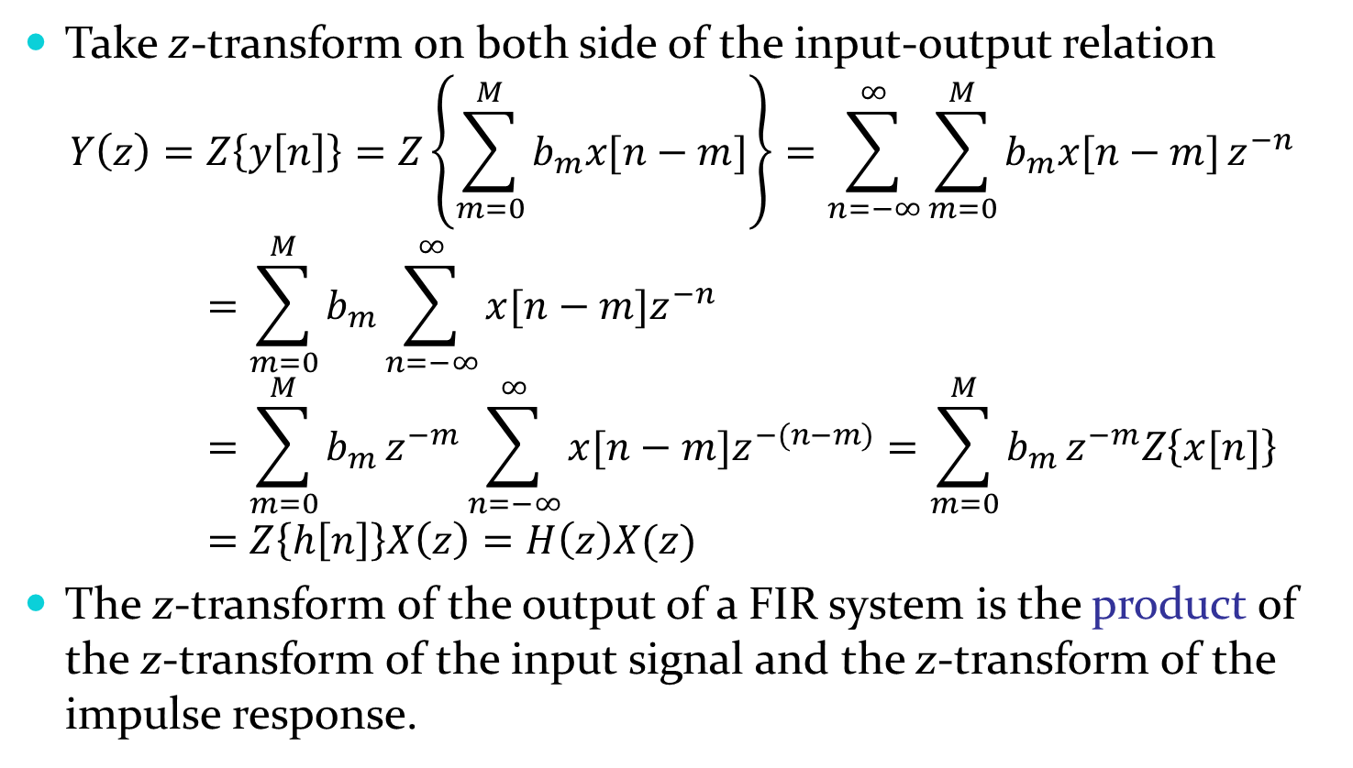
$z$-Transform of FIR System
Take $z$-transform on both side of the input-output relation
$$Y\left(z\right)=Z\left\{y\left[n\right]\right\}=Z\left\{\sum_{m=0}^{M}{b_{m}x[n−m]}\right\}=\sum_{n=−∞}^{∞}{\sum_{m=0}^{M}{b_{m}x[n−m]}z^{−n}}=\sum_{m=0}^{M}{b_{m}}\sum_{n=−∞}^{∞}{x[n−m]z^{−n}}=\sum_{m=0}^{M}{b_{m}}z^{−m}\sum_{n=−∞}^{∞}{x[n−m]z^{−(n−m)}}=\sum_{m=0}^{M}{b_{m}}z^{−m}Z\left\{x[n]\right\}=Z\left\{h\left[n\right]\right\}X\left(z\right)=H\left(z\right)X(z)$$
The z-transform of the output of a FIR system is the product of the z-transform of the input signal and the z-transform of the impulse response.

Slide 10



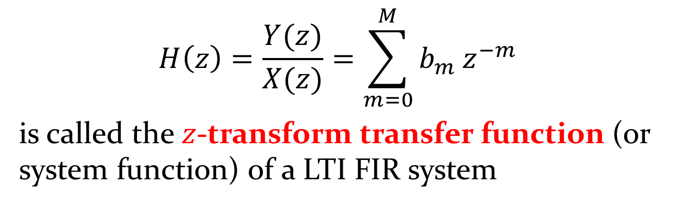


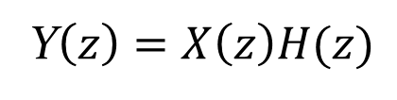


Transfer Function
$$x[n]$$
$$y[n]$$
$$h(n)$$
$$y\left[n\right]=x\left[n\right] h[n]$$
$$X(z)$$
$$Y(z)$$
$$H(z)$$
Y$\left(z\right)=X\left(z\right)H(z)$
$$H\left(z\right)=\frac{Y(z)}{X(z)}=\sum_{m=0}^{M}{b_{m}}z^{−m}$$
is called the $z$-transform transfer function (or system function) of a LTI FIR system

Slide 11
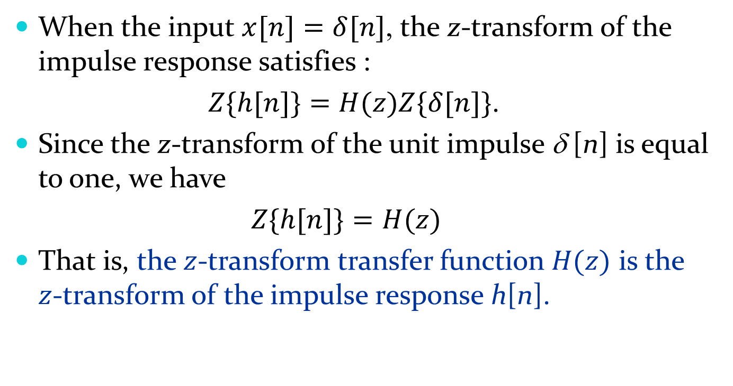
Transfer Function and Impulse Response
When the input $x[n]=δ[n]$, the z-transform of the impulse response satisfies :
$Z\{h[n]\}=H(z)Z\{δ[n]\}$.
Since the z-transform of the unit impulse δ [n] is equal to one, we have
$Z\{h[n]\}=H(z)$
That is, the $z$-transform transfer function $H(z)$ is the $z$-transform of the impulse response h[n].

Slide 12








Cascade & Parallel Connection
$$H1(z)$$
$$H2(z)$$
$$≡$$
$$H1(z)H2(z)$$
$$H1(z)$$
+
$$≡$$
$$H1(z)+H2(z)$$
$$H2(z)$$

Slide 13
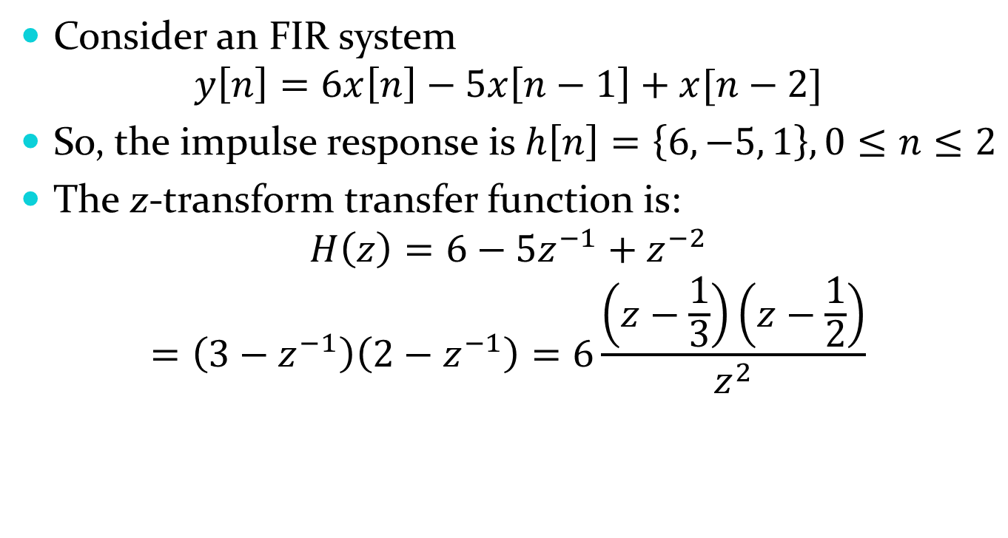
Example
Consider an FIR system
$$y\left[n\right]=6x\left[n\right]−5x\left[n−1\right]+x[n−2]$$
So, the impulse response is $h\left[n\right]=\left\{6, −5, 1\right\}, 0≤n≤2$
The z-transform transfer function is:
$$H\left(z\right)=6−5z^{−1}+z^{−2}$$
$$=\left(3−z^{−1}\right)\left(2−z^{−1}\right)=6\frac{\left(z−\frac{1}{3}\right)\left(z−\frac{1}{2}\right)}{z^{2}}$$

Slide 14






$z$-transform of Difference Equation
$$\sum_{m=0}^{N}{b_{m}y[n−m]}=\sum_{m=0}^{M}{a_{m}x[n−m]}$$
Revisit system diagram for normalized b₀ = 1
$$x[n]$$
a₀
$$y[n]$$
z⁻¹
z⁻¹
$$x[n−1]$$
a₁
− b₁
z⁻¹
z⁻¹
$$x[n−2]$$
a₂
− b₂
z⁻¹
z⁻¹
a_{M}
− b_{N}

Slide 15
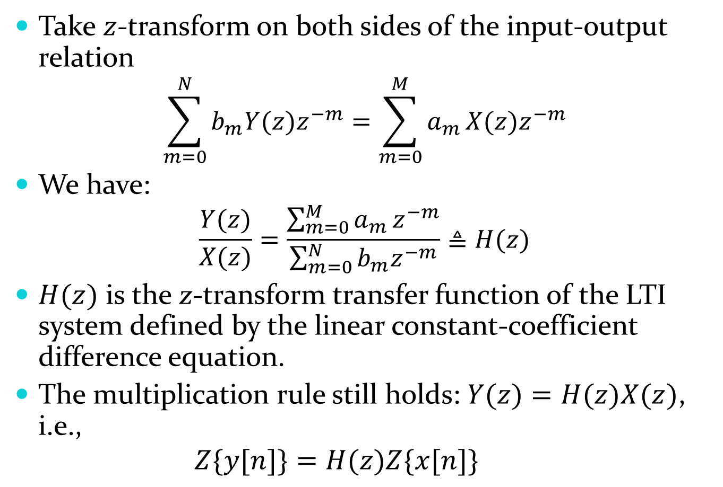
Take $z$-transform on both sides of the input-output relation
$$\sum_{m=0}^{N}{b_{m}{Y(z)z}^{−m}}=\sum_{m=0}^{M}{a_{m}}X(z)z^{−m}$$
We have:
$$\frac{Y(z)}{X(z)}=\frac{\sum_{m=0}^{M}{a_{m}}z^{−m}}{\sum_{m=0}^{N}{b_{m}z^{−m}}}≜H(z)$$
$H(z)$ is the z-transform transfer function of the LTI system defined by the linear constant-coefficient difference equation.
The multiplication rule still holds: $Y(z)=H(z)X(z)$, i.e.,
$$Z\{y[n]\}=H(z)Z\{x[n]\}$$

Slide 16
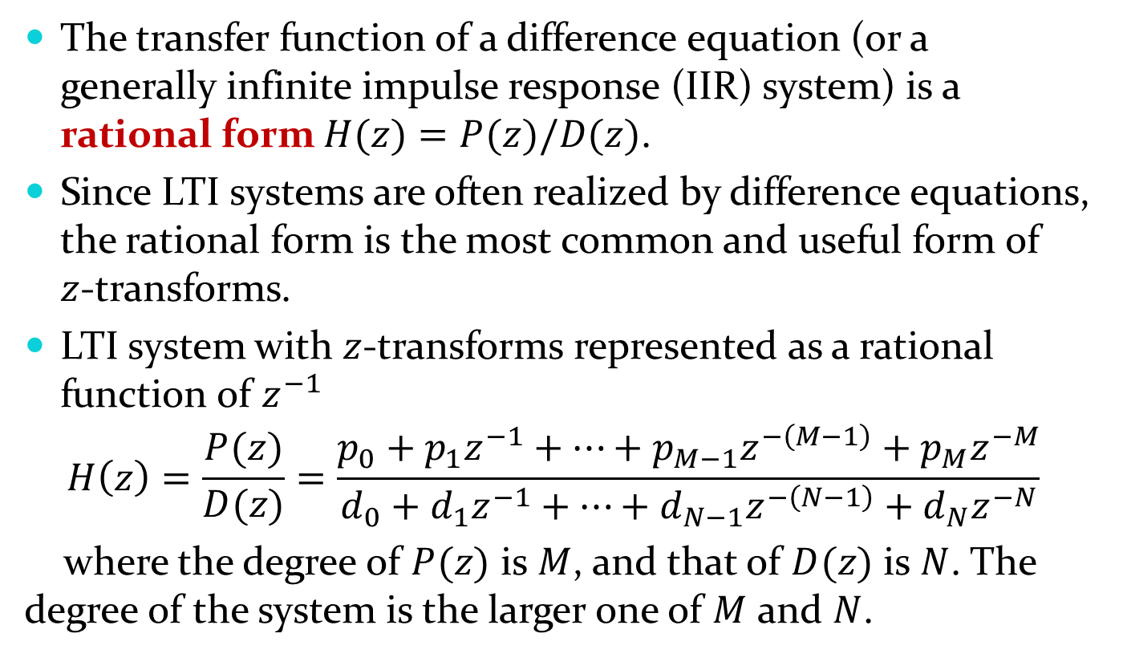

Rational $z$-transform
The transfer function of a difference equation (or a generally infinite impulse response (IIR) system) is a rational form $H(z)=P(z)/D(z)$.
Since LTI systems are often realized by difference equations, the rational form is the most common and useful form of $z$-transforms.
LTI system with $z$-transforms represented as a rational function of $z^{−1}$
$$H\left(z\right)=\frac{P(z)}{D(z)}=\frac{p_{0}+p_{1}z^{−1}+…+p_{M−1}z^{−\left(M−1\right)}+p_{M}z^{−M}}{d_{0}+d_{1}z^{−1}+…+d_{N−1}z^{−\left(N−1\right)}+d_{N}z^{−N}}$$
where the degree of $P(z)$ is $M$, and that of $D(z)$ is $N$. The degree of the system is the larger one of $M$ and $N$.

Slide 17
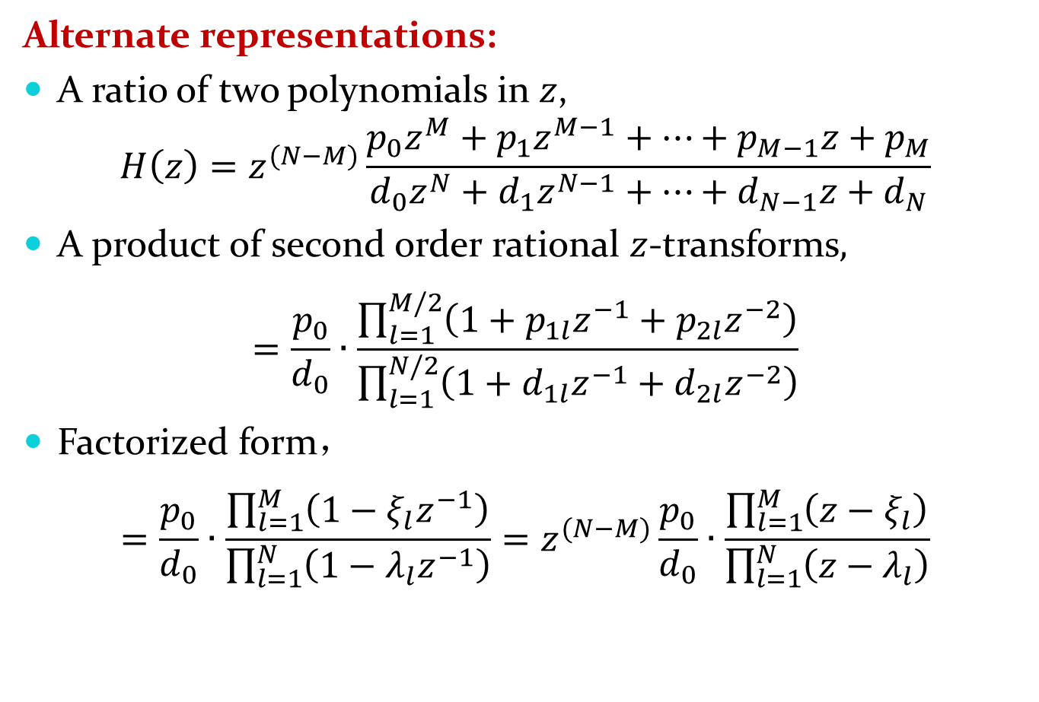
Alternate representations:
A ratio of two polynomials in $z$,
$$H\left(z\right)=z^{(N−M)}\frac{p_{0}z^{M}+p_{1}z^{M−1}+…+p_{M−1}z+p_{M}}{d_{0}z^{N}+d_{1}z^{N−1}+…+d_{N−1}z+d_{N}}$$
A product of second order rational $z$-transforms,
$$=\frac{p_{0}}{d_{0}}∙\frac{\prod_{l=1}^{M/2}{\left(1+p_{1l}z^{−1}+p_{2l}z^{−2}\right)}}{\prod_{l=1}^{N/2}{\left(1+d_{1l}z^{−1}+d_{2l}z^{−2}\right)}}$$
Factorized form，
$$=\frac{p_{0}}{d_{0}}∙\frac{\prod_{l=1}^{M}{\left(1−ξ_{l}z^{−1}\right)}}{\prod_{l=1}^{N}{\left(1−λ_{l}z^{−1}\right)}}=z^{(N−M)}\frac{p_{0}}{d_{0}}∙\frac{\prod_{l=1}^{M}{\left(z−ξ_{l}\right)}}{\prod_{l=1}^{N}{\left(z−λ_{l}\right)}}$$

Slide 18
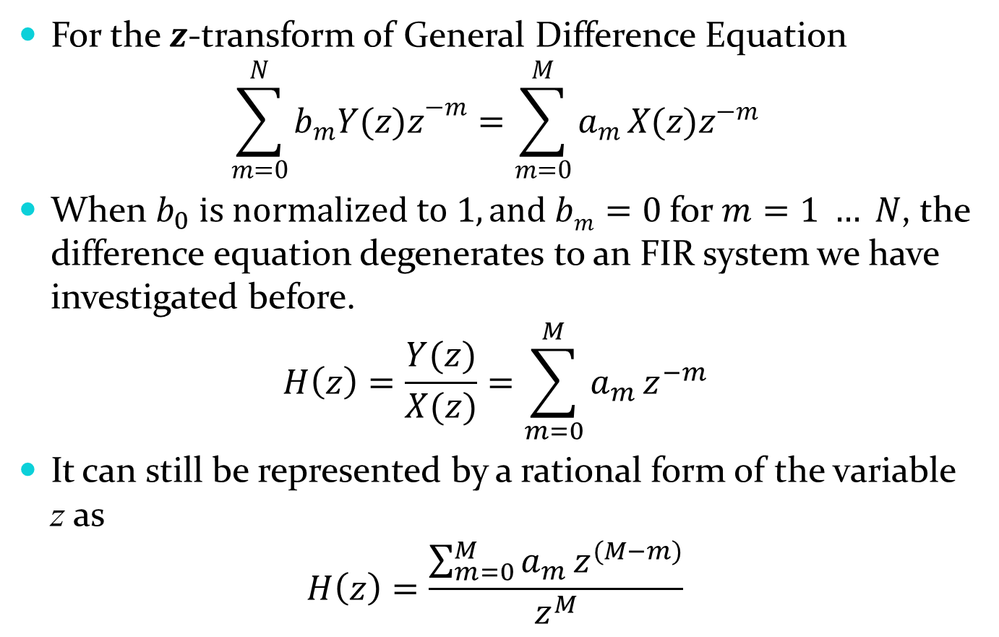
For the 𝒛-transform of General Difference Equation
$$\sum_{m=0}^{N}{b_{m}{Y(z)z}^{−m}}=\sum_{m=0}^{M}{a_{m}}X(z)z^{−m}$$
When $b_{0} is normalized to 1, and bm=0$for $m=1 … N$, the difference equation degenerates to an FIR system we have investigated before.
$$H\left(z\right)=\frac{Y(z)}{X(z)}=\sum_{m=0}^{M}{a_{m}}z^{−m}$$
It can still be represented by a rational form of the variable z as
$$H\left(z\right)=\frac{\sum_{m=0}^{M}{a_{m}}z^{(M−m)}}{z^{M}}$$

Slide 19
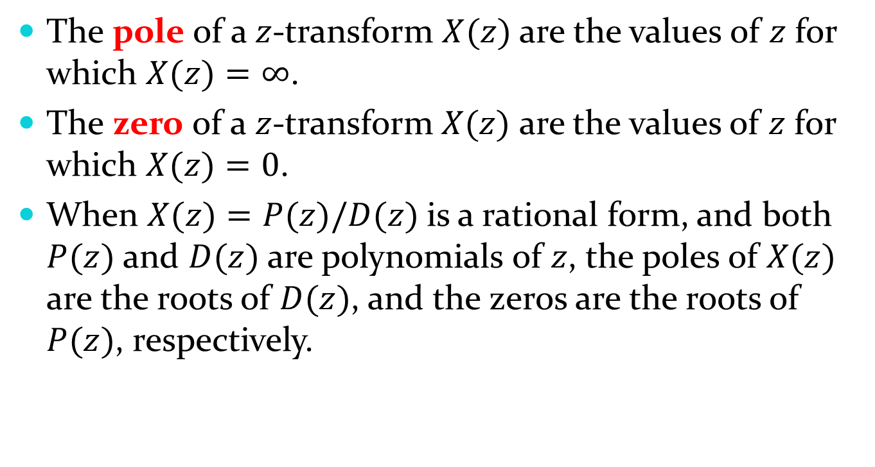
Poles and Zeros
The pole of a $z$-transform $X(z)$ are the values of $z$ for which $X(z)=∞$.
The zero of a $z$-transform $X(z)$ are the values of $z$ for which $X(z)=0$.
When $X(z)=P(z)/D(z)$is a rational form, and both $P(z)$ and $D(z)$are polynomials of $z$, the poles of $X(z)$ are the roots of $D(z)$, and the zeros are the roots of $P(z)$, respectively.

Slide 20
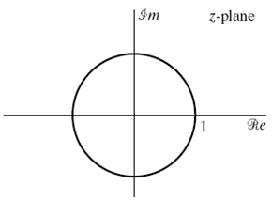
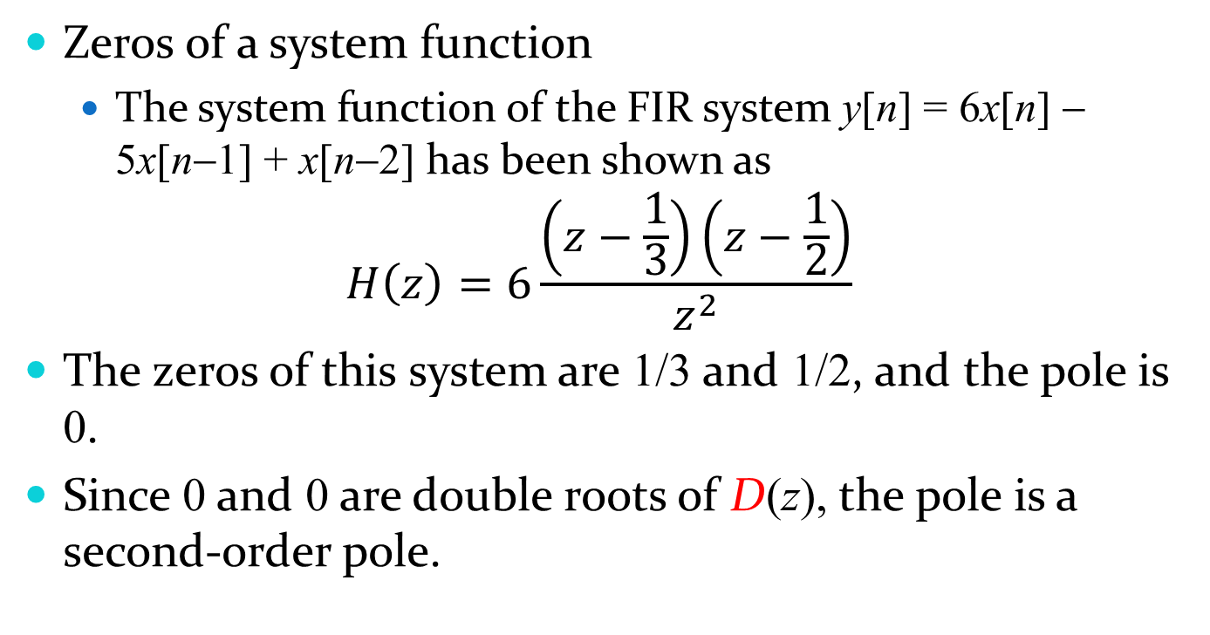
Examples
2
Zeros of a system function
The system function of the FIR system y[n] = 6x[n] − 5x[n−1] + x[n−2] has been shown as
$$H\left(z\right)=6\frac{\left(z−\frac{1}{3}\right)\left(z−\frac{1}{2}\right)}{z^{2}}$$
The zeros of this system are 1/3 and 1/2, and the pole is 0.
Since 0 and 0 are double roots of D(z), the pole is a second-order pole.

Slide 21
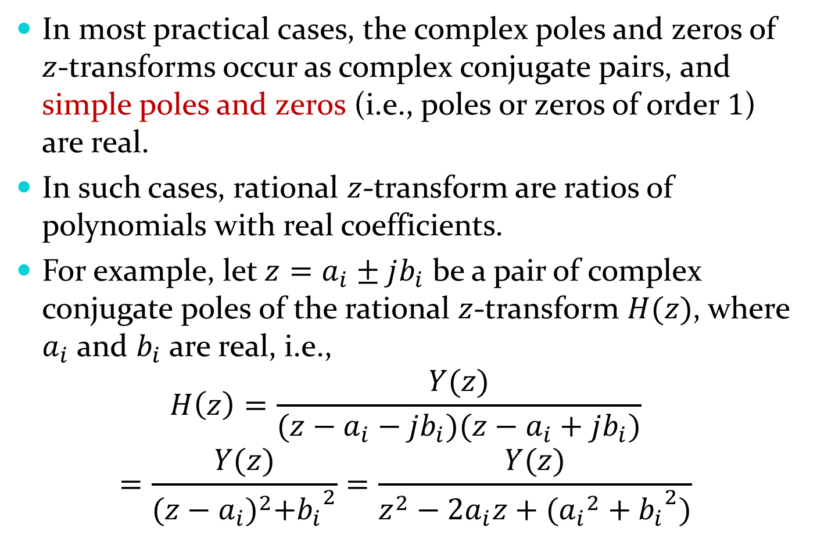
In most practical cases, the complex poles and zeros of $z$-transforms occur as complex conjugate pairs, and simple poles and zeros (i.e., poles or zeros of order $1$) are real.
In such cases, rational $z$-transform are ratios of polynomials with real coefficients.
For example, let $z=a_{i}±jb_{i}$ be a pair of complex conjugate poles of the rational $z$-transform $H(z)$, where $a_{i}$ and $b_{i}$ are real, i.e.,
$$H\left(z\right)=\frac{Y(z)}{(z−a_{i}−jb_{i})(z−a_{i}+jb_{i})}$$
$$=\frac{Y(z)}{{(z−a_{i})}^{2}+{b_{i}}^{2}}=\frac{Y(z)}{z^{2}−{2a}_{i}z+({a_{i}}^{2}+{b_{i}}^{2})}$$

Slide 22
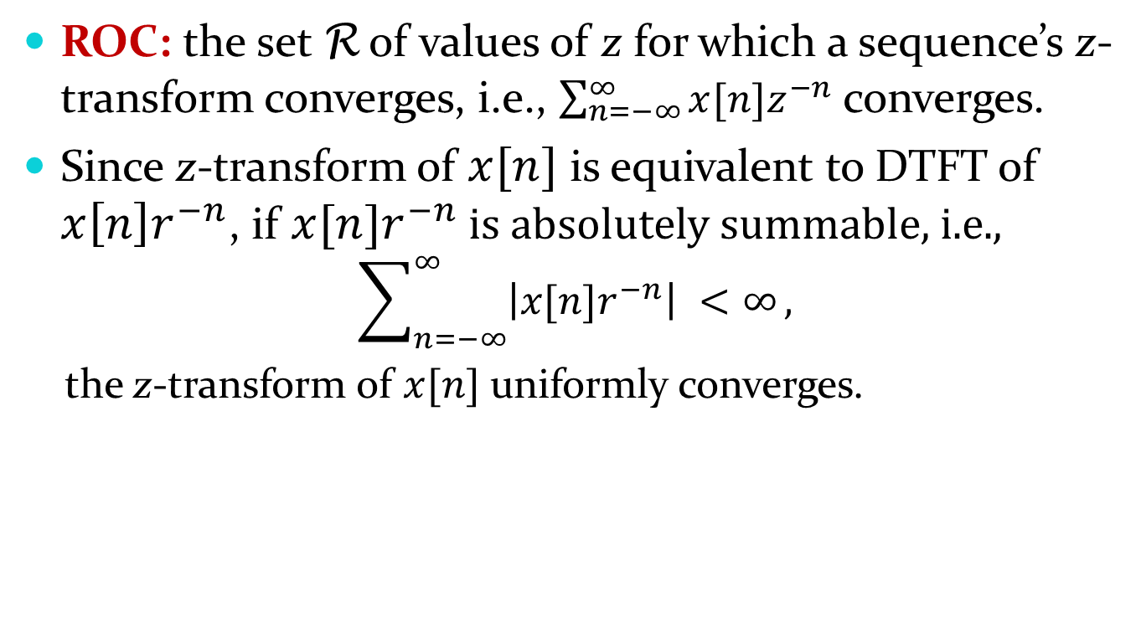
Region of Convergence (ROC)
ROC: the set R of values of z for which a sequence’s z-transform converges, i.e., $\sum_{n=−∞}^{∞}{x[n]z^{−n} }$converges.
Since z-transform of $x[n]$ is equivalent to DTFT of $x\left[n\right]r^{−n}$, if $x[n]r^{−n}$ is absolutely summable, i.e.,
$$\sum_{n=−∞}^{∞}{\left|x[n]r^{−n}\right| <∞},$$
the z-transform of $x[n]$ uniformly converges.

Slide 23
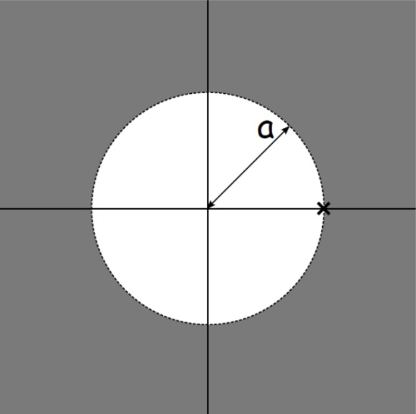
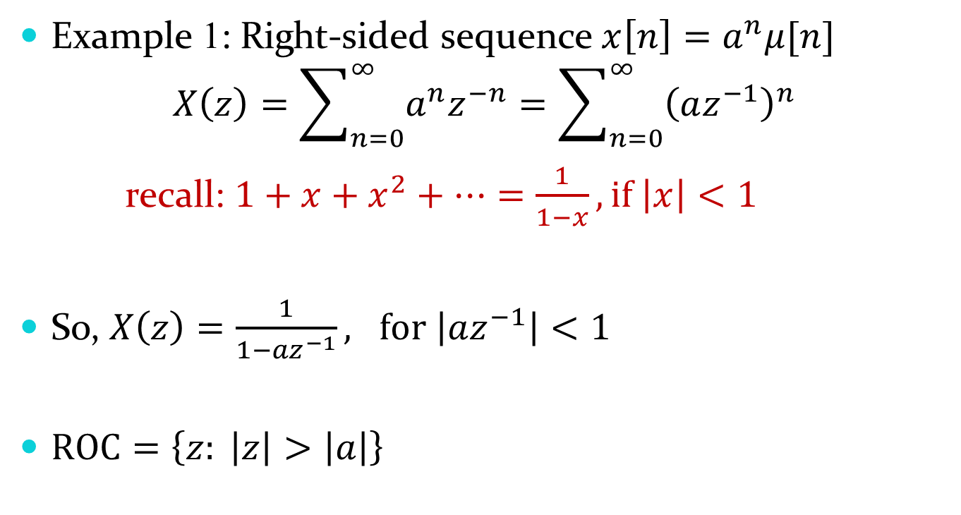
ROC examples
Example 1: Right-sided sequence $x\left[n\right]=a^{n}μ[n]$
$$X\left(z\right)=\sum_{n=0}^{∞}{a^{n}z^{−n}}=\sum_{n=0}^{∞}{{\left(az^{−1}\right)}^{n}}$$
recall: $1+x+x^{2}+…=\frac{1}{1−x}, if \left|x\right|<1$
So, $X\left(z\right)=\frac{1}{1−{az}^{−1}}, for \left|az^{−1}\right|<1$
$ROC=\left\{z: \left|z\right|>\left|a\right|\right\}$

Slide 24

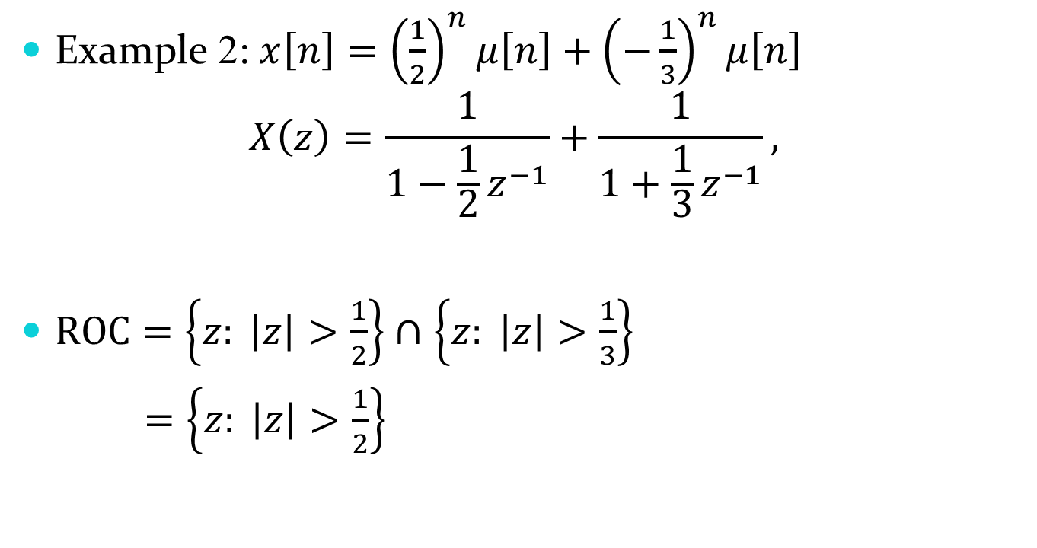

ROC examples
Example 2: $x\left[n\right]={\left(\frac{1}{2}\right)}^{n}μ\left[n\right]+{\left(−\frac{1}{3}\right)}^{n}μ\left[n\right]$
$$X\left(z\right)=\frac{1}{1−{\frac{1}{2}z}^{−1}}+\frac{1}{1+{\frac{1}{3}z}^{−1}},$$
$ROC=\left\{z: \left|z\right|>\frac{1}{2}\right\}∩$ $\left\{z: \left|z\right|>\frac{1}{3}\right\}$
$=\left\{z: \left|z\right|>\frac{1}{2}\right\}$
$$−\frac{1}{3}$$
$$\frac{1}{2}$$

Slide 25
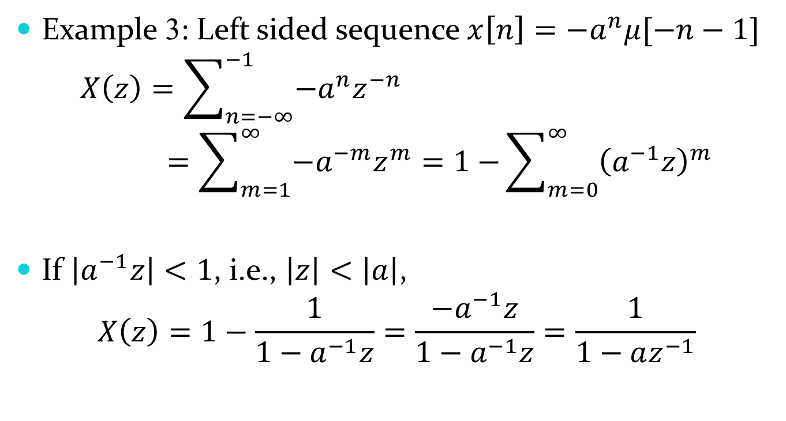
ROC examples
Example 3: Left sided sequence $x\left[n\right]={−a}^{n}μ[−n−1]$
$$X\left(z\right)=\sum_{n=−∞}^{−1}{{−a}^{n}z^{−n}}=\sum_{m=1}^{∞}{−a^{−m}z^{m}=1−}\sum_{m=0}^{∞}{{\left(a^{−1}z\right)}^{m}}$$
If $\left|a^{−1}z\right|<1$, i.e., $\left|z\right|<\left|a\right|$,
$$X\left(z\right)=1−\frac{1}{1−a^{−1}z}=\frac{−a^{−1}z}{1−a^{−1}z}=\frac{1}{1−az^{−1}}$$

Slide 26
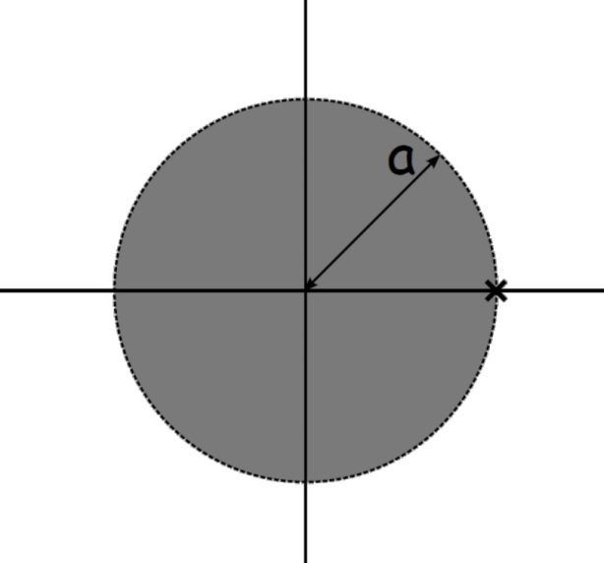
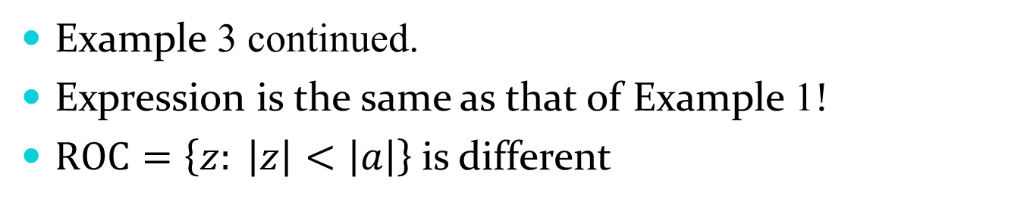
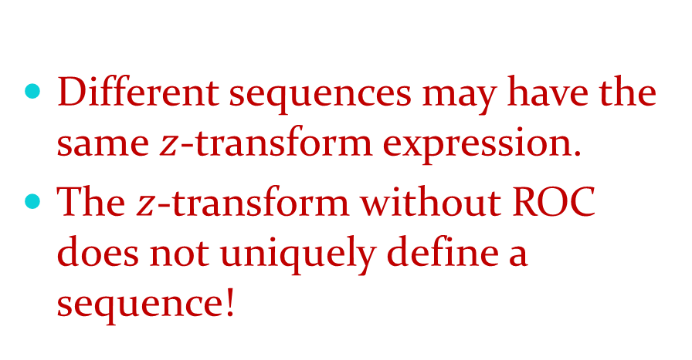
ROC examples
Example 3 continued.
Expression is the same as that of Example 1!
$ROC=\left\{z: \left|z\right|<\left|a\right|\right\}$is different
Different sequences may have the same $z$-transform expression.
The $z$-transform without ROC does not uniquely define a sequence!

Slide 27
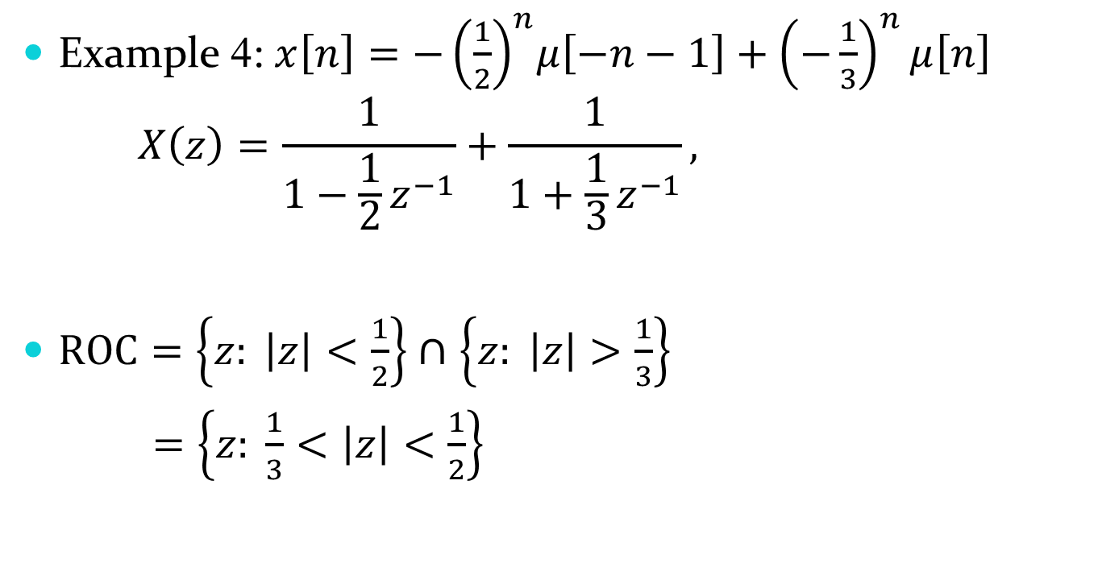

ROC examples
Example 4: $x\left[n\right]={−\left(\frac{1}{2}\right)}^{n}μ\left[−n−1\right]+{\left(−\frac{1}{3}\right)}^{n}μ\left[n\right]$
$$X\left(z\right)=\frac{1}{1−{\frac{1}{2}z}^{−1}}+\frac{1}{1+{\frac{1}{3}z}^{−1}},$$
$ROC=\left\{z: \left|z\right|<\frac{1}{2}\right\}∩$ $\left\{z: \left|z\right|>\frac{1}{3}\right\}$
$=\left\{z: \frac{1}{3}<\left|z\right|<\frac{1}{2}\right\}$
Expression Same as that of Example 2
$$−\frac{1}{3}$$
$$\frac{1}{2}$$
.

Slide 28
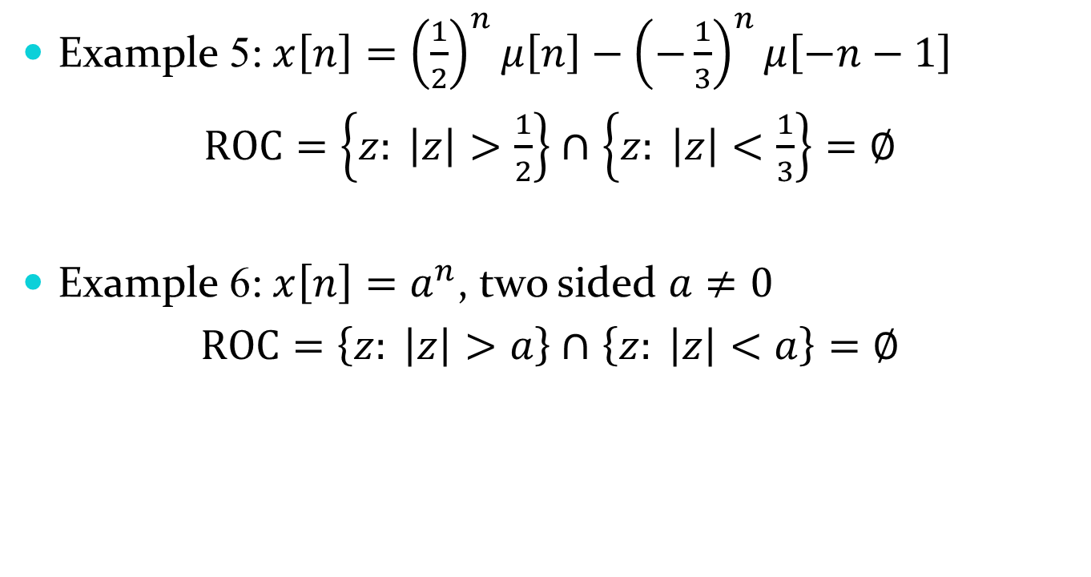
ROC examples
Example 5: $x\left[n\right]={\left(\frac{1}{2}\right)}^{n}μ\left[n\right]−{\left(−\frac{1}{3}\right)}^{n}μ\left[−n−1\right]$
$ROC=\left\{z: \left|z\right|>\frac{1}{2}\right\}∩$ $\left\{z: \left|z\right|<\frac{1}{3}\right\}=∅$
Example 6: $x\left[n\right]=a^{n}$, two sided $a≠0$
$ROC=\left\{z: \left|z\right|>a\right\}∩$ $\left\{z: \left|z\right|<a\right\}=∅$

Slide 29
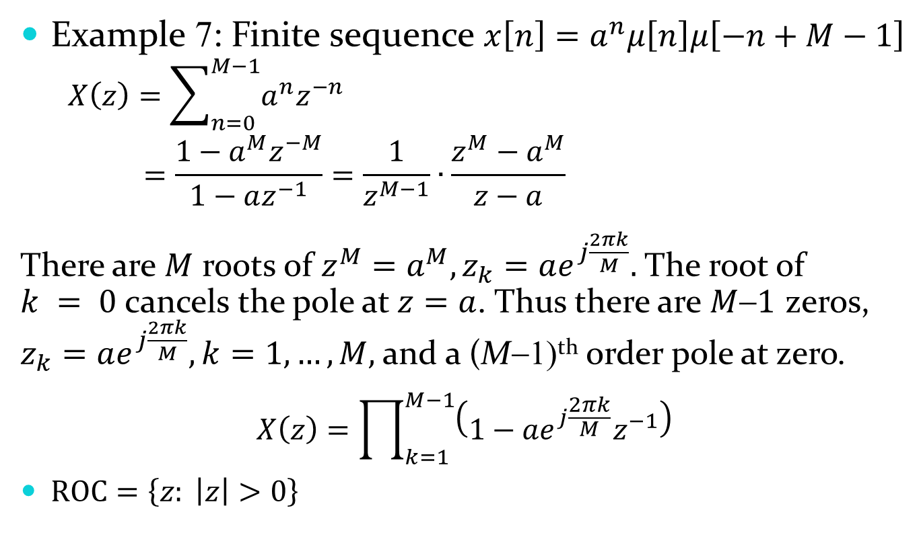
ROC Examples
Example 7: Finite sequence $x\left[n\right]=a^{n}μ\left[n\right]μ\left[−n+M−1\right]$
$$X\left(z\right)=\sum_{n=0}^{M−1}{a^{n}z^{−n}}$$
$$=\frac{1−a^{M}z^{−M}}{1−az^{−1}}=\frac{1}{z^{M−1}}∙\frac{z^{M}−a^{M}}{z−a}$$
There are $M$ roots of $z^{M}=a^{M}, z_{k}=ae^{j\frac{2πk}{M}}.$ The root of $k = 0$ cancels the pole at $z=a$. Thus there are $M1$ zeros, $z_{k}=ae^{j\frac{2πk}{M}}, k=1, …, M,$and a (M−1)^{th} order pole at zero.
$$X\left(z\right)=\prod_{k=1}^{M−1}{\left(1−{ae}^{j\frac{2πk}{M}}z^{−1}\right)}$$
$ROC=\left\{z: \left|z\right|>0\right\}$
Finite, always converges
Zero cancels pole

Slide 30
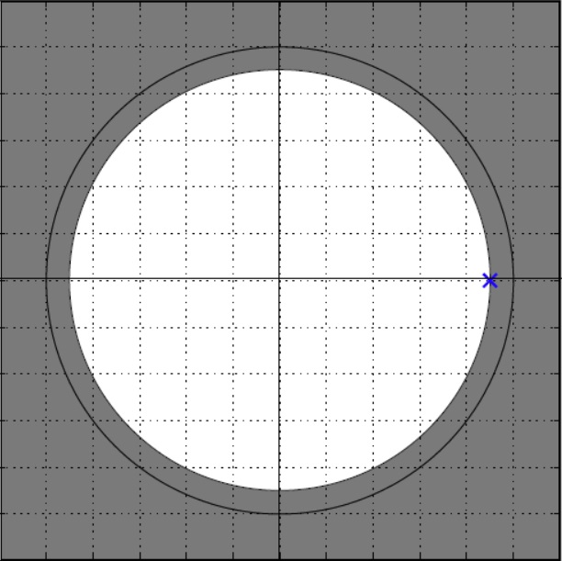
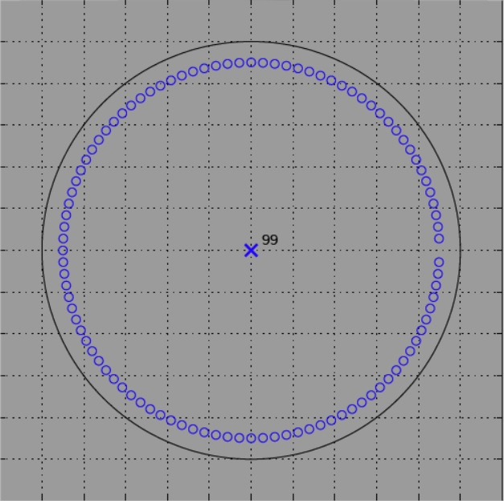
ROC examples
Example 7 continued:
Infinite Sequence
Finite Sequence

Slide 31
Properties of ROC
For right-sided sequences: ROC extends outward from the outermost pole to infinity
Examples 1, 2
For left-sided: ROC inwards from the inner most pole to the original point.
Example 3
For two-sided: ROC either is a ring - or do not exist
Examples 4, 5, 6

Slide 32


Properties of ROC
For finite duration sequences, ROC is the entire z-plane, except possibly z=0, z=∞
0
$$X\left(z\right)=1+z^{−1}+z^{−2}+z^{−3}$$
ROC excludes z = 0
0
$$X\left(z\right)=1+z^{1}+z^{2}$$
ROC excludes z = ∞

Slide 33
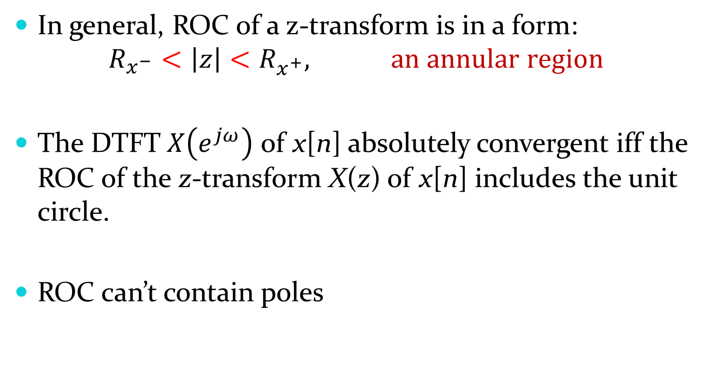
Properties of ROC
In general, ROC of a z-transform is in a form:
$$R_{x^{−}}<\left|z\right|<R_{x^{+}}, an annular region$$
The DTFT$X\left(e^{jω}\right)$ of x[n] absolutely convergent iff the ROC of the z-transform X(z) of x[n] includes the unit circle.
ROC can’t contain poles

Slide 34
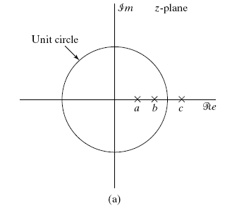
Example
(a) A system with three poles.

Slide 35
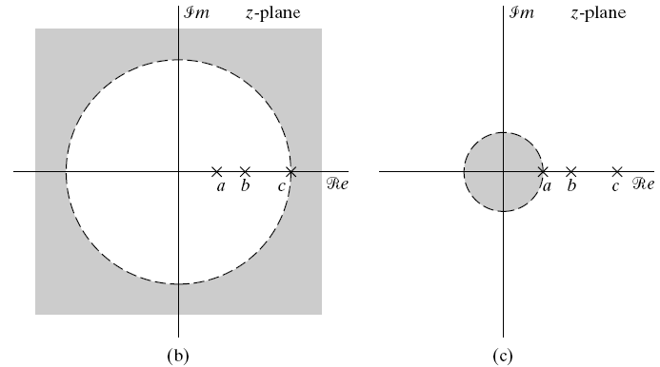
Different possibilities of the ROC. (b) ROC to a right-sided sequence. (c) ROC to a left-sided sequence.

Slide 36
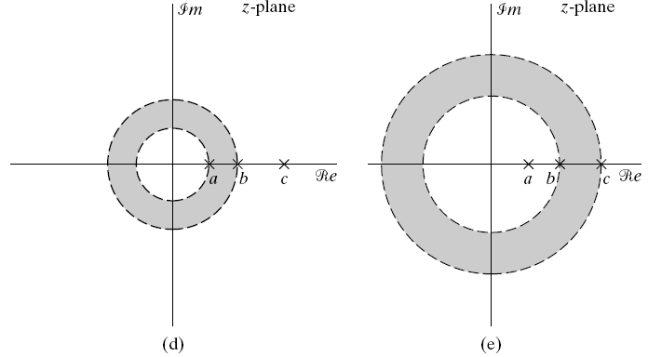
Different possibilities of the ROC. (d) ROC to a two-sided sequence. (e) ROC to another two-sided sequence.

Slide 37
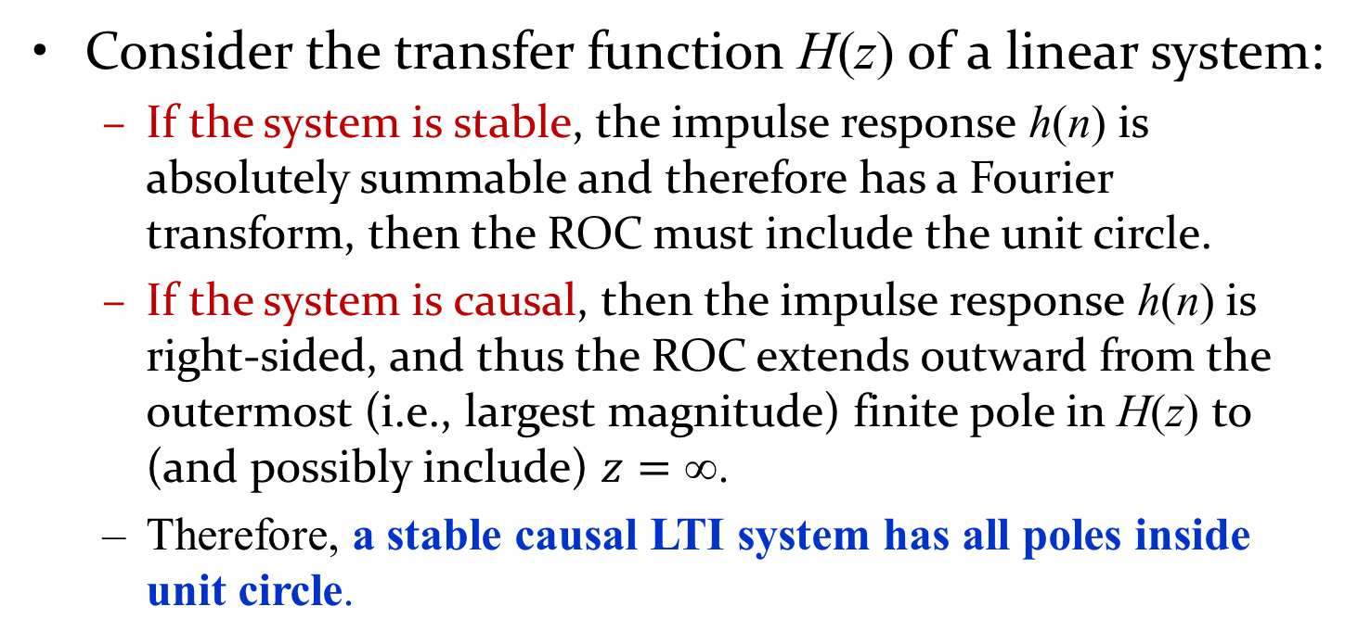
ROC for LTI System
Consider the transfer function H(z) of a linear system:
If the system is stable, the impulse response h(n) is absolutely summable and therefore has a Fourier transform, then the ROC must include the unit circle.
If the system is causal, then the impulse response h(n) is right-sided, and thus the ROC extends outward from the outermost (i.e., largest magnitude) finite pole in H(z) to (and possibly include) $z=$.
Therefore, a stable causal LTI system has all poles inside unit circle.

Slide 38
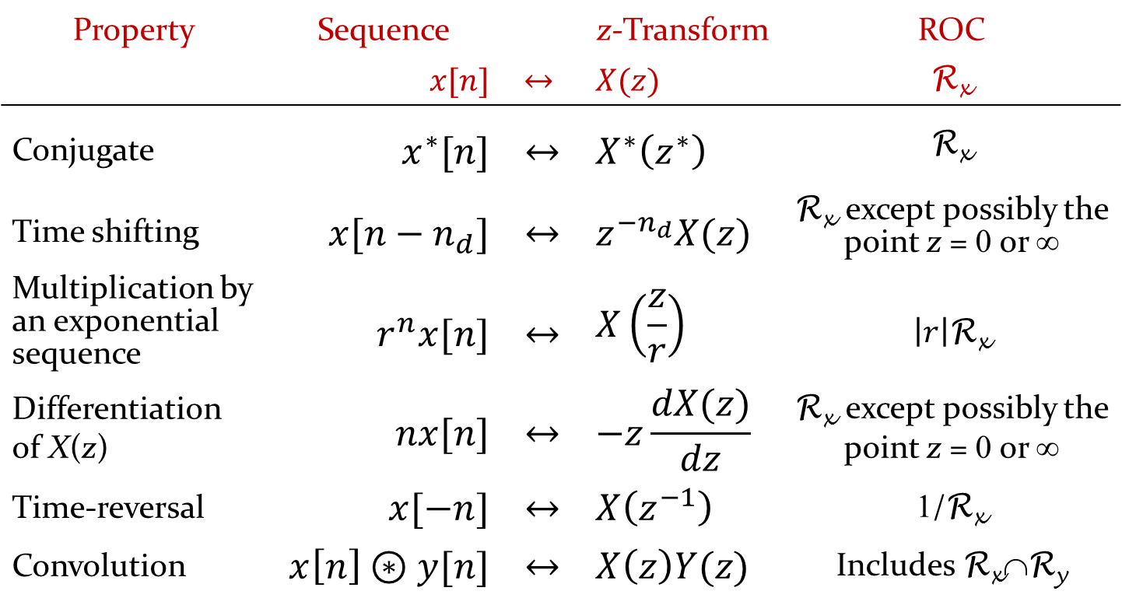
Properties of the z-transform
Property | Sequence |  | z-Transform | ROC
 | $$x[n]$$ | $$↔$$ | $$X(z)$$ | R_{x}
Conjugate | $$x^{∗}[n]$$ | $$↔$$ | $$X^{∗}\left(z^{∗}\right)$$ | R_{x}
Time shifting | $$x[n−n_{d}]$$ | $$↔$$ | $$z^{−n_{d}}X(z)$$ | R_{x} except possibly the point z = 0 or ∞
Multiplication by an exponential sequence | $$r^{n}x[n]$$ | $$↔$$ | $$X\left(\frac{z}{r}\right)$$ | $\left|r\right|$R_{x}
Differentiation of X(z) | $$nx[n]$$ | $$↔$$ | $$−z\frac{dX(z)}{dz}$$ | R_{x} except possibly the point z = 0 or ∞
Time-reversal | $$x[−n]$$ | $$↔$$ | $$X\left(z^{−1}\right)$$ | 1/R_{x}
Convolution | $$x\left[n\right]⊛y[n]$$ | $$↔$$ | $$X\left(z\right)Y(z)$$ | Includes R_{x}∩R_{y}

Slide 39
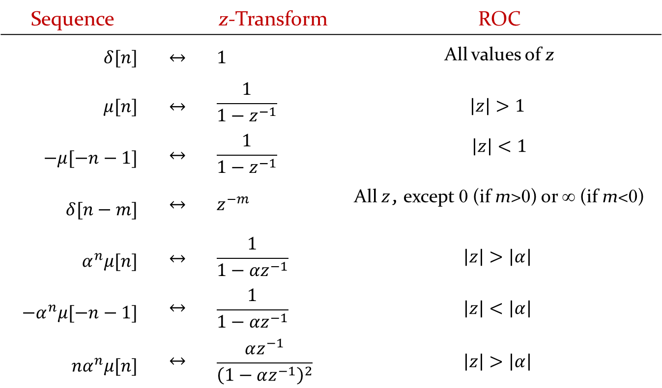
Commonly Used z-transform Pairs
Sequence |  | z-Transform | ROC
$$δ[n]$$ | $$↔$$ | $$1$$ | All values of z
$$μ[n]$$ | $$↔$$ | $$\frac{1}{1−z^{−1}}$$ | $$\left|z\right|>1$$
$$−μ[−n−1]$$ | $$↔$$ | $$\frac{1}{1−z^{−1}}$$ | $$\left|z\right|<1$$
$$δ[n−m]$$ | $$↔$$ | $$z^{−m}$$ | All $z$, except 0 (if m>0) or ∞ (if m<0)
$$α^{n}μ[n]$$ | $$↔$$ | $$\frac{1}{1−αz^{−1}}$$ | $$\left|z\right|>\left|α\right|$$
$${−α}^{n}μ[−n−1]$$ | $$↔$$ | $$\frac{1}{1−αz^{−1}}$$ | $$\left|z\right|<\left|α\right|$$
$${nα}^{n}μ[n]$$ | $$↔$$ | $$\frac{αz^{−1}}{{\left(1−αz^{−1}\right)}^{2}}$$ | $$\left|z\right|>\left|α\right|$$

Slide 40
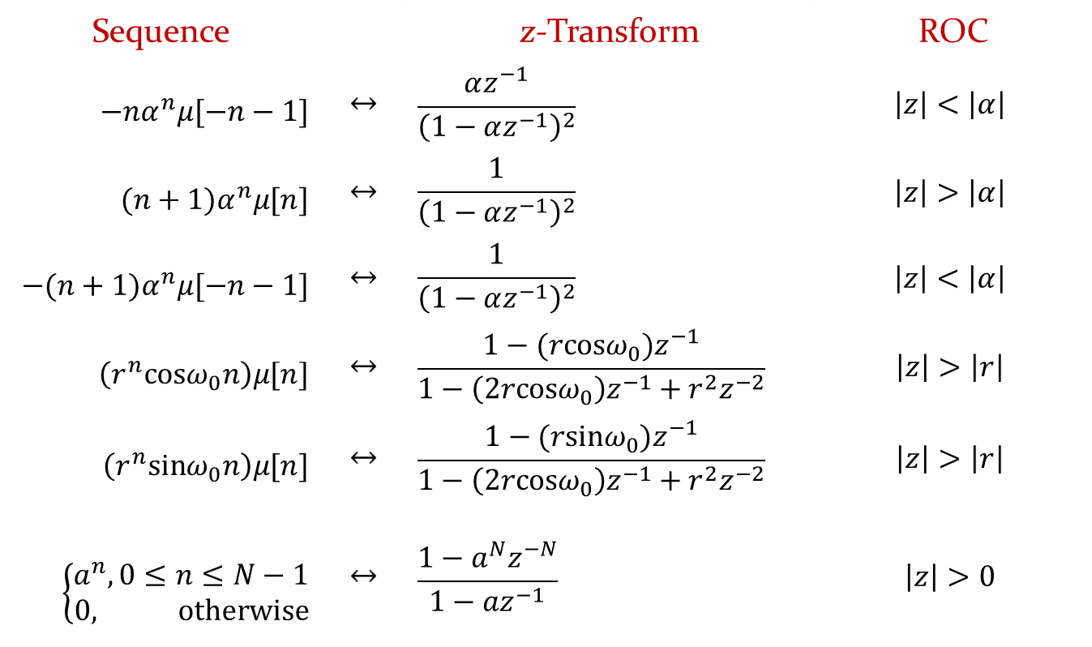
Commonly Used z-transform Pairs
Sequence |  | z-Transform | ROC
$${−nα}^{n}μ[−n−1]$$ | $$↔$$ | $$\frac{αz^{−1}}{{\left(1−αz^{−1}\right)}^{2}}$$ | $$\left|z\right|<\left|α\right|$$
$$({n+1)α}^{n}μ[n]$$ | $$↔$$ | $$\frac{1}{{\left(1−αz^{−1}\right)}^{2}}$$ | $$\left|z\right|>\left|α\right|$$
$$−({n+1)α}^{n}μ[−n−1]$$ | $$↔$$ | $$\frac{1}{{\left(1−αz^{−1}\right)}^{2}}$$ | $$\left|z\right|<\left|α\right|$$
$$\left(r^{n}cosω_{0}n\right)μ[n]$$ | $$↔$$ | $$\frac{1−(rcosω_{0})z^{−1}}{1−\left(2rcosω_{0}\right)z^{−1}+r^{2}z^{−2}}$$ | $$\left|z\right|>\left|r\right|$$
$$\left(r^{n}sinω_{0}n\right)μ[n]$$ | $$↔$$ | $$\frac{1−(rsinω_{0})z^{−1}}{1−\left(2rcosω_{0}\right)z^{−1}+r^{2}z^{−2}}$$ | $$\left|z\right|>\left|r\right|$$
$$\left\{\begin{aligned}a^{n}, 0≤n≤N−1 \\ 0, otherwise\end{aligned}\right.$$ | $$↔$$ | $$\frac{1−a^{N}z^{−N}}{1−az^{−1}}$$ | $$\left|z\right|>0$$

Slide 41
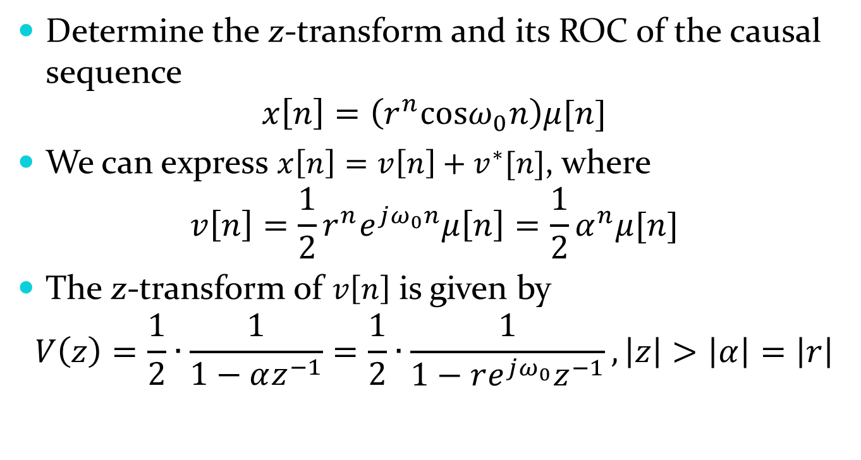
Example
Determine the z-transform and its ROC of the causal sequence
$$x\left[n\right]=\left(r^{n}cosω_{0}n\right)μ[n]$$
We can express $x\left[n\right]=v\left[n\right]+v^{∗}[n]$, where
$$v\left[n\right]=\frac{1}{2}r^{n}e^{jω_{0}n}μ\left[n\right]=\frac{1}{2}α^{n}μ[n]$$
The z-transform of $v\left[n\right]$ is given by
$$V\left(z\right)=\frac{1}{2}∙\frac{1}{1−αz^{−1}}=\frac{1}{2}∙\frac{1}{1−re^{jω_{0}}z^{−1}}, \left|z\right|>\left|α\right|=\left|r\right|$$

Slide 42
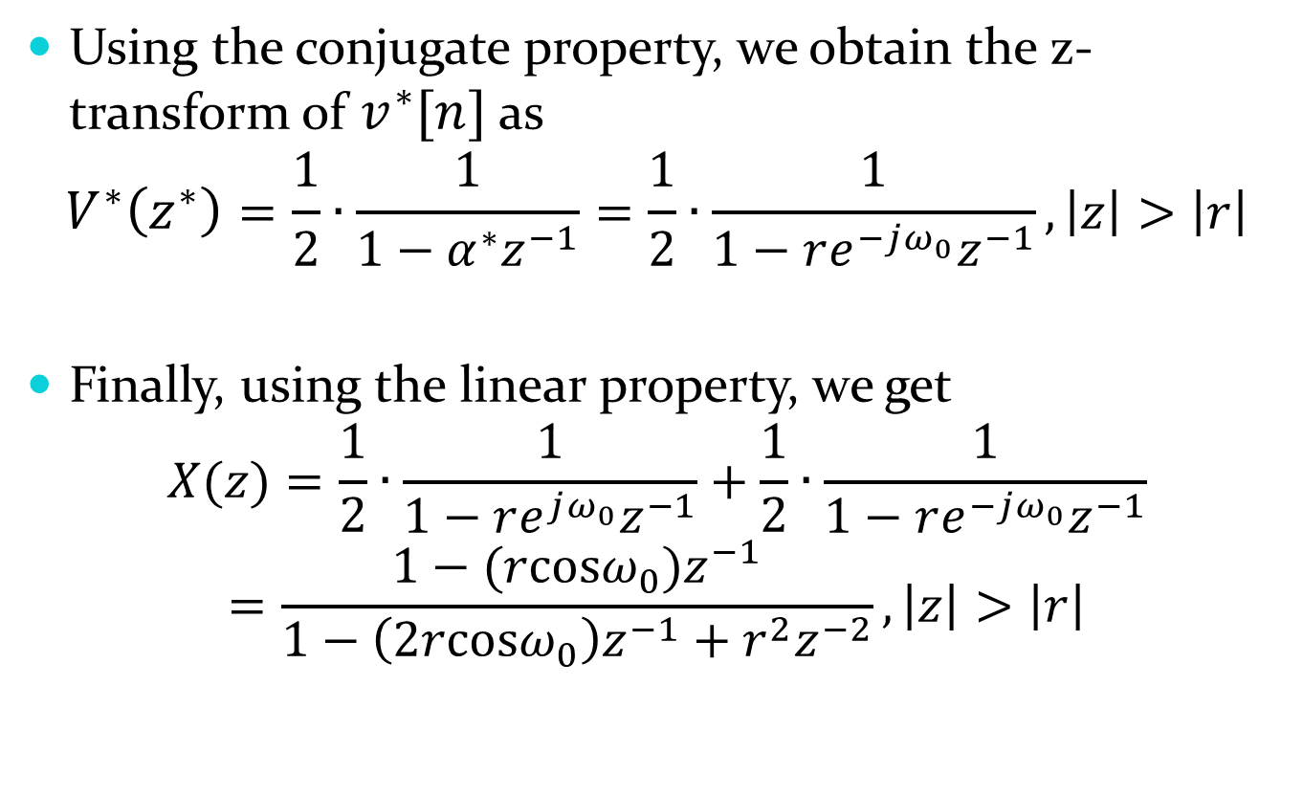
Using the conjugate property, we obtain the z-transform of $v^{∗}[n]$ as
$$V^{∗}\left(z^{∗}\right)=\frac{1}{2}∙\frac{1}{1−α^{∗}z^{−1}}=\frac{1}{2}∙\frac{1}{1−re^{−jω_{0}}z^{−1}}, \left|z\right|>\left|r\right|$$
Finally, using the linear property, we get
$$X(z)=\frac{1}{2}∙\frac{1}{1−re^{jω_{0}}z^{−1}}+\frac{1}{2}∙\frac{1}{1−re^{−jω_{0}}z^{−1}}$$
$$=\frac{1−(rcosω_{0})z^{−1}}{1−\left(2rcosω_{0}\right)z^{−1}+r^{2}z^{−2}},\left|z\right|>\left|r\right|$$

Slide 43
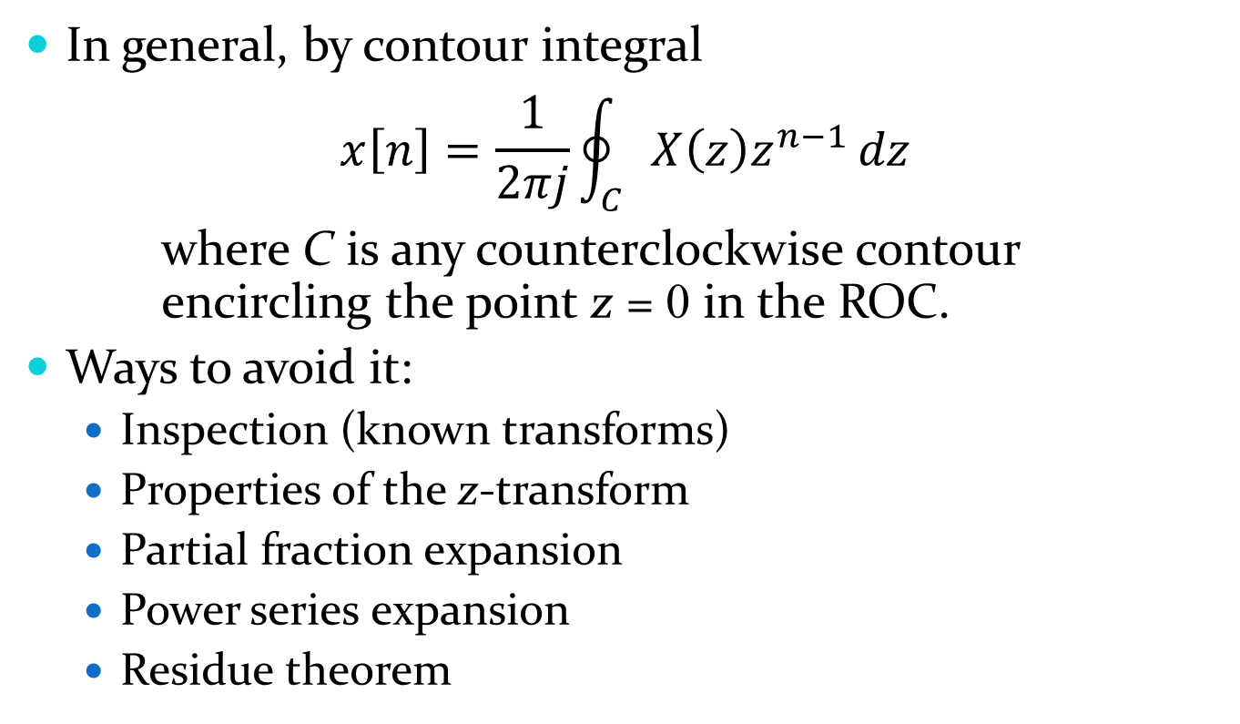
Inversion of the z-Transform
In general, by contour integral
$$x\left[n\right]=\frac{1}{2πj}\oint_{C}{X\left(z\right)z^{n−1}}dz$$
where C is any counterclockwise contour encircling the point z = 0 in the ROC.
Ways to avoid it:
Inspection (known transforms)
Properties of the z-transform
Partial fraction expansion
Power series expansion
Residue theorem

Slide 44
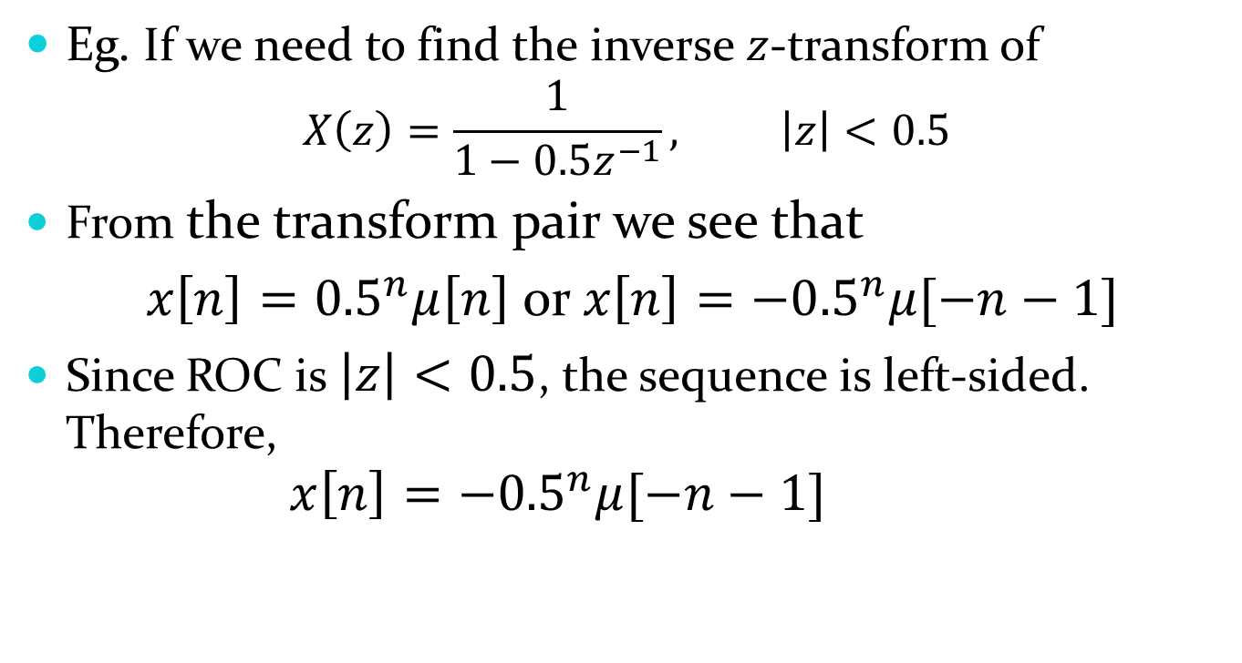
By Inspection
Eg. If we need to find the inverse $z$-transform of
$$X\left(z\right)=\frac{1}{1−0.5z^{−1}}, \left|z\right|<0.5$$
From the transform pair we see that
${x\left[n\right]=0.5}^{n}μ\left[n\right]$ or ${x\left[n\right]=−0.5}^{n}μ[−n−1]$
Since ROC is $\left|z\right|<0.5$, the sequence is left-sided. Therefore,
$${x\left[n\right]=−0.5}^{n}μ[−n−1]$$

Slide 45
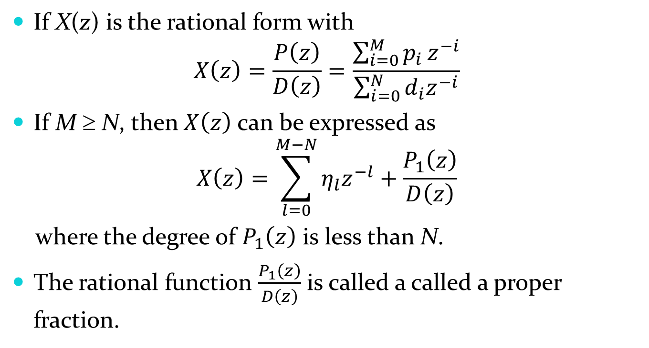
By Partial Fraction Expansion
If X(z) is the rational form with
$$X\left(z\right)=\frac{P\left(z\right)}{D\left(z\right)}=\frac{\sum_{i=0}^{M}{p_{i}}z^{−i}}{\sum_{i=0}^{N}{d_{i}z^{−i}}}$$
If M ≥ N, then $X\left(z\right)$ can be expressed as
$$X\left(z\right)=\sum_{l=0}^{M−N}{η_{l}z^{−l}}+\frac{P_{1}\left(z\right)}{D\left(z\right)}$$
where the degree of $P_{1}\left(z\right)$ is less than N.
The rational function $\frac{P_{1}\left(z\right)}{D\left(z\right)}$ is called a called a proper fraction.

Slide 46
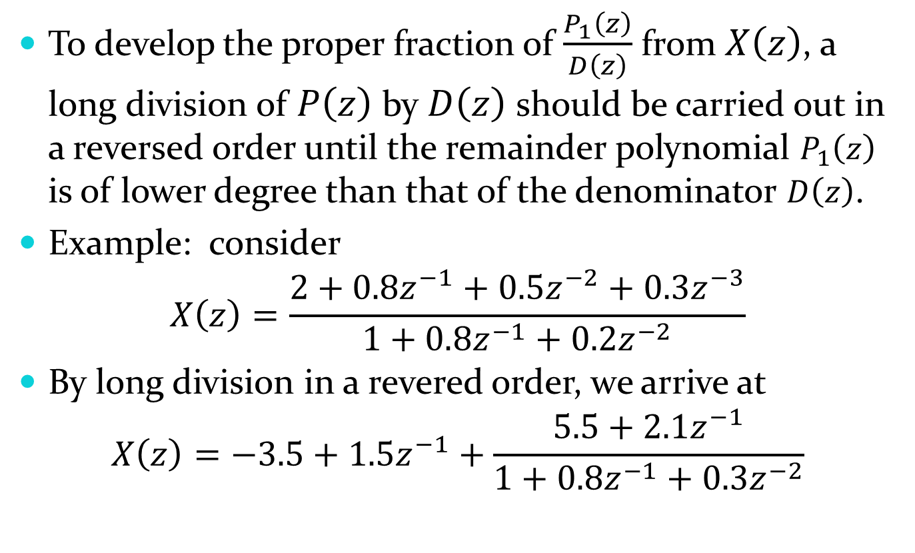
To develop the proper fraction of $\frac{P_{1}\left(z\right)}{D\left(z\right)}$ from $X\left(z\right)$, a long division of $P\left(z\right)$ by $D\left(z\right)$ should be carried out in a reversed order until the remainder polynomial $P_{1}\left(z\right)$ is of lower degree than that of the denominator $D\left(z\right)$.
Example: consider
$$X\left(z\right)=\frac{2+0.8z^{−1}+0.5z^{−2}+0.3z^{−3}}{1+0.8z^{−1}+0.2z^{−2}}$$
By long division in a revered order, we arrive at
$$X\left(z\right)=−3.5+1.5z^{−1}+\frac{5.5+2.1z^{−1}}{1+0.8z^{−1}+0.3z^{−2}}$$
Proper fraction

Slide 47
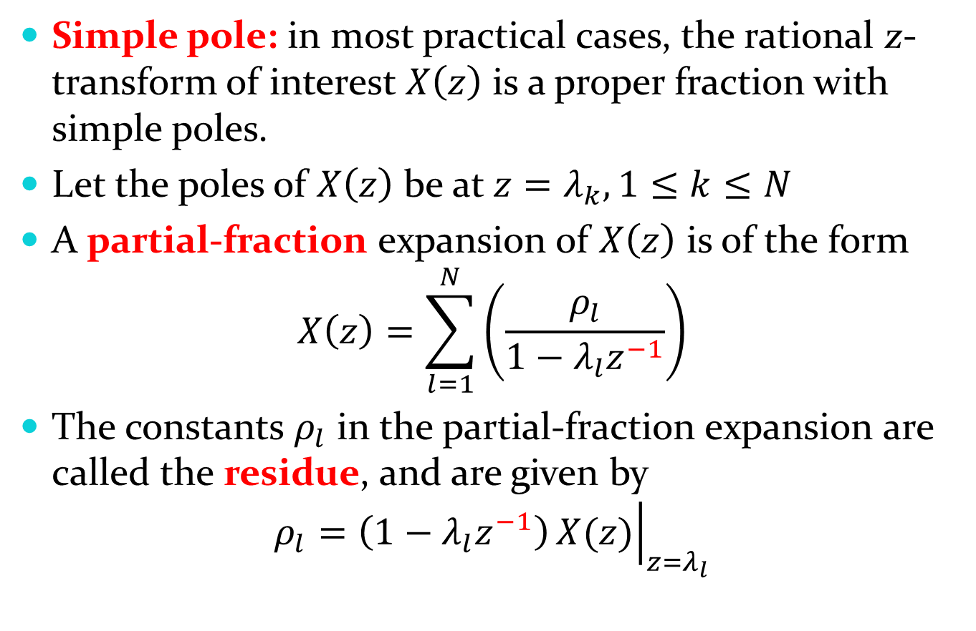
Simple pole: in most practical cases, the rational z-transform of interest $X\left(z\right)$ is a proper fraction with simple poles.
Let the poles of $X\left(z\right)$ be at $z=λ_{k}, 1≤k≤N$
A partial-fraction expansion of $X\left(z\right)$ is of the form
$$X\left(z\right)=\sum_{l=1}^{N}{\left(\frac{ρ_{l}}{1−λ_{l}z^{−1}}\right)}$$
The constants $ρ_{l}$ in the partial-fraction expansion are called the residue, and are given by
$$ρ_{l}=\left(1−λ_{l}z^{−1}\right){\left.X(z)\right|}_{z=λ_{l}}$$

Slide 48

Assume that each term of the sum in partial-fraction expansion has an ROC given by $|z|>\left|λ_{l}\right|$ , and thus has an inverse transform of the form $ρ_{l}{\left(λ_{l}\right)}^{n}μ[n]$.
Therefore, the inverse transform $x[n]$ of $X(z)$ is given by
$$x\left[n\right]=\sum_{l=1}^{N}{ρ_{l}{\left(λ_{l}\right)}^{n}μ[n]}$$

Slide 49

Example
Let the $z$-transform $H\left(z\right)$ of a causal system $h[n]$ is given by
$$H\left(z\right)=1+\frac{z(z+2)}{\left(z−0.2\right)\left(z+0.6\right)}=1+\frac{1+2z^{−1}}{\left(1−0.2z^{−1}\right)\left(1+0.6z^{−1}\right)}$$
The second term is a proper fraction. A partial-fraction expansion of $H\left(z\right)$ is then of form
$$H\left(z\right)=1+\frac{ρ_{1}}{1−0.2z^{−1}}+\frac{ρ_{2}}{1+0.6z^{−1}}$$
And
$$ρ_{1}=\left(1−0.2z^{−1}\right){\left.\frac{1+2z^{−1}}{\left(1−0.2z^{−1}\right)\left(1+0.6z^{−1}\right)}\right|}_{z=0.2}=2.75$$
$$ρ_{2}=\left(1+0.6z^{−1}\right){\left.\frac{1+2z^{−1}}{\left(1−0.2z^{−1}\right)\left(1+0.6z^{−1}\right)}\right|}_{z=−0.6}=−1.75$$

Slide 50

Thus, we have
$$H\left(z\right)=1+\frac{2.75}{1−0.2z^{−1}}+\frac{−1.75}{1+0.6z^{−1}}$$
Since it is given that $h\left[n\right]$ is causal, the inverse transform of the above is given by
$$h\left[n\right]=δ\left[n\right]+2.75{\left(0.2\right)}^{n}μ\left[n\right]−1.75{\left(−0.6\right)}^{n}μ[n]$$

Slide 51

Another example
Find the inverse $z$-transform of
$$X\left(z\right)=\frac{{\left(1+z^{−1}\right)}^{2}}{\left(1−\frac{1}{2}z^{−1}\right)\left(1−z^{−1}\right)}, \left|z\right|>1$$
Since both the numerator and denominator are of degree 2, a constant term exists.
$$X\left(z\right)=B_{0}+\frac{A_{1}}{\left(1−\frac{1}{2}z^{−1}\right)}+\frac{A_{2}}{\left(1−z^{−1}\right)}$$
$B_{0}$ can be determined by the fraction of the coefficients of $z^{−2}$. $B_{0}=\frac{1}{\frac{1}{2}}=2$.

Slide 52

Therefore, $X\left(z\right)=2+\frac{−1+5z^{−1}}{\left(1−\frac{1}{2}z^{−1}\right)\left(1−z^{−1}\right)}=2+\frac{A_{1}}{\left(1−\frac{1}{2}z^{−1}\right)}+\frac{A_{2}}{\left(1−z^{−1}\right)}$
$$A_{1}=\frac{−1+5z^{−1}}{\left(1−\frac{1}{2}z^{−1}\right)\left(1−z^{−1}\right)}∙{\left.\left(1−{\frac{1}{2}z}^{−1}\right)\right|}_{z=\frac{1}{2}}=−9$$
$$A_{2}=\frac{−1+5z^{−1}}{\left(1−\frac{1}{2}z^{−1}\right)\left(1−z^{−1}\right)}∙{\left.\left(1−z^{−1}\right)\right|}_{z=1}=8$$
$$X\left(z\right)=2−\frac{9}{\left(1−\frac{1}{2}z^{−1}\right)}+\frac{8}{\left(1−z^{−1}\right)}$$
From the ROC, the solution is right-handed. So
$$x\left[n\right]=2δ\left[n\right]−9{\left(\frac{1}{2}\right)}^{n}μ\left[n\right]+8μ[n]$$

Slide 53

By Power Series Expansion
$$X\left(z\right)=\sum_{n=−∞}^{∞}{x[n]z^{−n}}=…+x\left[−2\right]z^{2}+x\left[−1\right]z+x\left[0\right]+x\left[1\right]z^{−1}+x\left[2\right]z^{−2}+…$$
We can determine any particular value of the sequence by finding the coefficient of the appropriate power of $z^{−1}$.

Slide 54

Example: Finite-length Sequence
Find the inverse z-transform of
$$X\left(z\right)=z^{2}\left(1−0.5z^{−1}\right)\left(1+z^{−1}\right)\left(1−z^{−1}\right)$$
By directly expand X(z), we have
$$X\left(z\right)=z^{2}−0.5z−1+0.5z^{−1}$$
Thus,
$$x\left[n\right]=δ\left[n+2\right]−0.5δ\left[n+1\right]−δ\left[n\right]+0.5δ[n−1]$$

Slide 55

Example: Rational z-Transform
If a rational z-transform is expressed as a ratio of polynomials in $z^{−1}$, the power series expansion can be obtained by long division.
Consider
$$H\left(z\right)=\frac{1+2z^{−1}}{1+0.4z^{−1}−0.12z^{−2}}$$
The long division of the numerator by the denominator yields
$$H\left(z\right)=1+1.6z^{−1}−0.52z^{−2}+0.4z^{−3}−0.2224z^{−4}+…$$
Thus, $h\left[n\right]=δ\left[n\right]+1.6δ\left[n−1\right]−0.52δ\left[n−2\right]+0.4δ\left[n−3\right]−0.2224δ\left[n−4\right]+…$

Slide 56

Frequency Response from Transfer Function
$z$-transform transfer function
$$H\left(z\right)=H_{re}\left(z\right)+jH_{im} \left(z\right)=\left|H\left(z\right)\right|e^{jargH(z)}$$
where $argH\left(z\right)=\tan^{−1}{\frac{H_{im}(z)}{H_{re}(z)}}$
If the ROC of $H\left(z\right)$ includes the unit circle, the frequency response $H\left(e^{jω}\right)$ of the LTI digital system can be obtained by evaluating $H\left(z\right)$ on the unit circle:
$$H\left(e^{jω}\right)={\left.H(z)\right|}_{z=e^{jω}}$$
For a real coefficient transfer function
$${\left|H(e^{jω})\right|}^{2}=H\left(e^{jω}\right)H^{∗}\left(e^{jω}\right)=H\left(e^{jω}\right)H\left(e^{−jω}\right)$$
$$={\left.H(z)H(z^{−1})\right|}_{z=e^{jω}}$$

Slide 57

Stability Condition in Terms of Pole Locations
A stable causal LTI system has all poles inside unit circle.
A causal LTI FIR digital filter with bounded impulse response coefficients is always stable, as all its poles are at the origin in the $z$-plane.
A causal LTI IIR digital filter may or may not be stable.
An originally stable IIR filter characterized by infinite precision coefficients and with all poles inside the unit circle may become unstable after implementation due to the unavoidable quantization of all coefficients.

Slide 58

Example
Analyze the stability of
$$H\left(z\right)=\frac{1}{1−1.845z^{−1}+0.850586z^{−2}}$$
and the system implemented by keeping $2$ digits after the decimal points of the coefficients.
A: the poles of the systems are the roots of
$$1−1.845z^{−1}+0.850586z^{−2}=z^{−2}\left(z^{2}−1.845z^{1}+0.850586\right)$$
We have, $z_{p}=\frac{1.845±\sqrt{{1.845}^{2}−4×0.850586}}{2}=0.943, or 0.902$
Both poles are in the unit circle, and the system is stable.

Slide 59

If the system is implemented by keeping 2 digits after the decimal points of the coefficients, the transfer function becomes
$$H\left(z\right)=\frac{1}{1−1.85z^{−1}+0.85z^{−2}}$$
The root of the denominator is
$$z_{p}=\frac{1.85±\sqrt{{1.85}^{2}−4×0.85}}{2}=1, or 0.85$$
i.e., one pole is on the unit circle. So the system becomes unstable.

